Slide 1
VATS

Slide 2
Contact Information
Soham Vakani: vakanisa@mail.uc.edu | (513) 501 - 1165
Thomas Turner: turnetg@mail.uc.edu | (513) 432-8498
Skyler Simpson: simpsosk@mail.uc.edu | (614) 940-4119
Ary Sharma: sharm3a8@mail.uc.edu | (614) 767-9771
Advisor:
Medhi Norouzi (Mentor): norouzmi@ucmail.uc.edu

Slide 3
Purpose & Goals
Create an AI-powered minigame where users describe a character in natural language, and AI models generate both the character’s attributes and sprite for an interactive minigame.
Apply machine learning concepts like NLP and generative modeling in a fun, interactive way while building a full end-to-end system from text input to playable game using the Godot game engine.

Slide 4
Project Abstract
Our project is an AI-powered sprite generation system, combining machine learning with interactive gameplay
Users will type in a short description (e.g., “a fast ninja with fire powers”), and our system will use natural language processing to translate the description into attributes for sprite generation and game development
A corresponding 2D sprite will then be generated and it will be playable in a simple mini-game
We plan to incorporate machine learning at multiple stages, including text-to-attribute mapping, sprite or ability generation

Slide 5
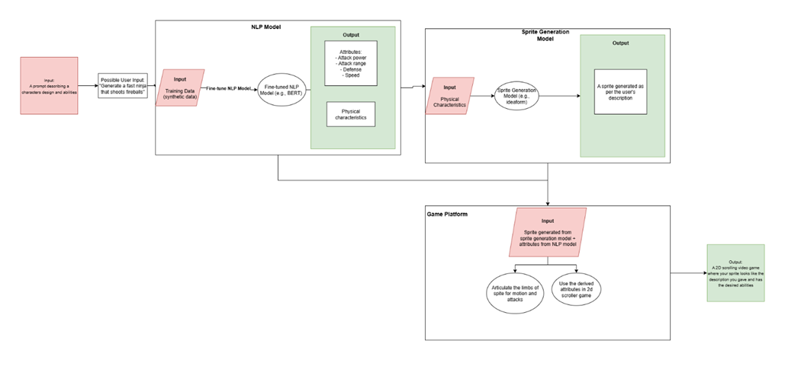
User Stories & Diagrams
User Stories:
As an end user, I want to be able to input the description of a simple video game character into a text field.
As an end user, I want the software to be able to generate a character that fits the description that I entered including physical appearance and stats.
As an end user, I want to able to interact with the video game that was generated with the character that was generated based on my description

Slide 6
Constraints
The three topical areas that we researched were economic, professional, and legal constraints:
Economic constraints:
  API Usage billing (e.g., $0.0079 for each 64x64 image, $0.0132 per image for each 400x400)
  Other costs may emerge as we continue development on the project
Professional constraints:
  Limited experience working with AI models
Legal constraints:
  Our project must comply with copyright and data usage laws
  The sprites and character models generated through our pipeline must not infringe on any third-party intellectual property

Slide 7
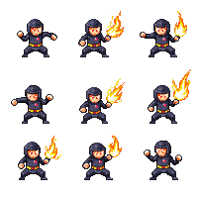
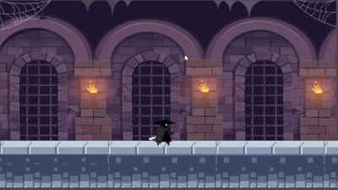
Progress
NLP Model: Worked on converting user input into JSON attributes with character attributes and color template for PixelLab API Call.
Working on standardizing output for consistent API calls and sprite generation
PixelLab API Calls: Tested PixelLab API with example sprite descriptions and received high quality sprite generation inspiring confidence in our selection of the model.
Game Development: Started initial prototyping of side scroller game in Godot with sample character and sword animation.

Slide 8
Expected Accomplishments
By the end of the semester and starting the Spring semester the expected accomplishments are:
Build and test baseline NLP model pipeline (description -> attributes/abilities/physical characteristic): create and run a full pipeline all the way from user input to sprite generation to game generation. Test with various inputs and fix bugs
Utilize the physical characteristics from the NLP model to generate a sprite: Use an API or the fine-tuned model to generate the sprite per the output of the NLP model

Slide 9
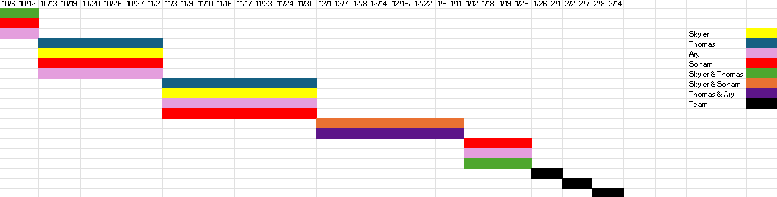
Division of Work
NLP Model (Soham)
Sprite Generation (Ary)
Game Logic and Development (Skyler & Thomas)

Slide 10
Expected Demo at Expo
At the CEAS Expo, we expect to demonstrate our project’s image generation capabilities and allow users to play with the characters they described in a simple 2D platform game
Users will be able to type in their text prompt and see their minigame generated in a couple of minutes and be able to play it for a short demo and attack a villain.

